Slide 1


vs

Slide 2
Automated Build and Deployment of Tomcat Apps
Presented by: Chris Peck
Institution/Company: College of William and Mary
Date: 9/29/2014
Session ID: 8743

Slide 3
Session Rules of Etiquette
Please silence your cell phone/pager
If you must leave the session early, please do so as discreetly as possible
Please avoid side conversation during the session
Please, feel free to ask questions at any time
Thank you for your cooperation!

Slide 4
Introduction
This presentation will describe our journey to an automated process for building and deploying Apps to a Tomcat server. We plan to use this process for XE Apps.
The focus will be on using a variety of open-source “DevOps” tools.
A live demo – what could go wrong???

Slide 5
Introductions
About me
*Nix sysadmin at William and Mary since 1998
Not a Developer
Used to “hand-craft” all our servers & applications, everything was a “snowflake”
Now we automate and define by code almost everything, we make snowballs out of snowflakes
Notes:
This is my second time at MABUG, and, my first time speaking at MABUG and in about 20 years

Slide 6
Introductions
About you
Who are the Devs here?
Who are the Ops here?
Who is neither?
Who’s already doing this?
Who has a pager? Please hold it up for the younger folks to see.

Slide 7
Learning Outcomes of this session:
Discuss various “DevOps” tools available
Discuss what can be done with them
Learn where to get them, they’re all open-source
Notes:
Extra Billy’sSmokehouse & Brewery

Slide 8
Agenda:
Pre-Jenkins – how we used to do this
Post-Jenkins – automation is sweet
Live Demo
Discuss the tools & how to get them
Q&A

Slide 9
Pre-Jenkins
Grails warfile built on Devs desktop
Warfile uploaded to a Shared Net Drive
Devs then ping Ops to deploy
Ops copy warfile to server, then deploy it
Note: We’re actually called Unix Engineering, but, I’ll be referring to our team as “Ops”.

Slide 10
Pre-Jenkins Issues
Grails warfile built on Devs desktop
Java on their desktop
Grails on their Desktop
Build & Testing done on a Windows Desktop usually
Classic “but it ran ok on my Desktop” scenario

Slide 11
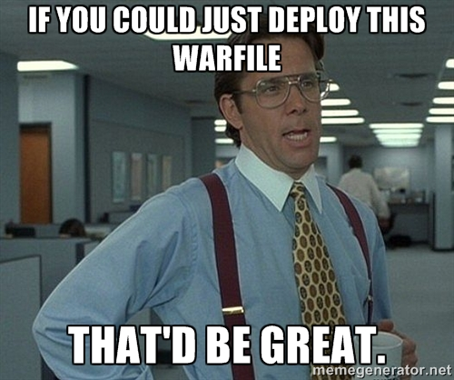
Pre-Jenkins Issues

Slide 12
Pre-Jenkins Issues
Devs ping Ops to deploy
Slows down the process
Ops copies warfile to server
Ops don’t use Windows - PITA getting the file
Fragile process, must get the correct file and deploy to the correct server and location

Slide 13
What is Jenkins?
“Jenkins is an award-winning application that monitors executions of repeated jobs.”
Ops had been using it for:
CAS - built & half-deployed
Puppet manifest – tested and deployed
Sympa Source - built, and, half-deployed

Slide 14
Post Jenkins
Dev pushes code to git
Git pings Jenkins it has something for it
Jenkins git’s the updated code
Jenkins builds a warfile
Jenkins “deploys” the warfile to Tomcat

Slide 15
Post-Jenkins Pros
Jenkins server runs the same:
OS – built on the same image as the Tocmat servers
Java
Tomcat
Warfile is built automatically at check-in
Jenkins deploys the correct warfile to the correct server

Slide 16
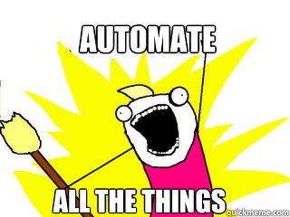

Slide 17
Demonstration
Vagrant – tool to create reproducible dev VM’s
OS – built on the same image as the servers using packer
Software – installed using the same Puppet manifest

Slide 18
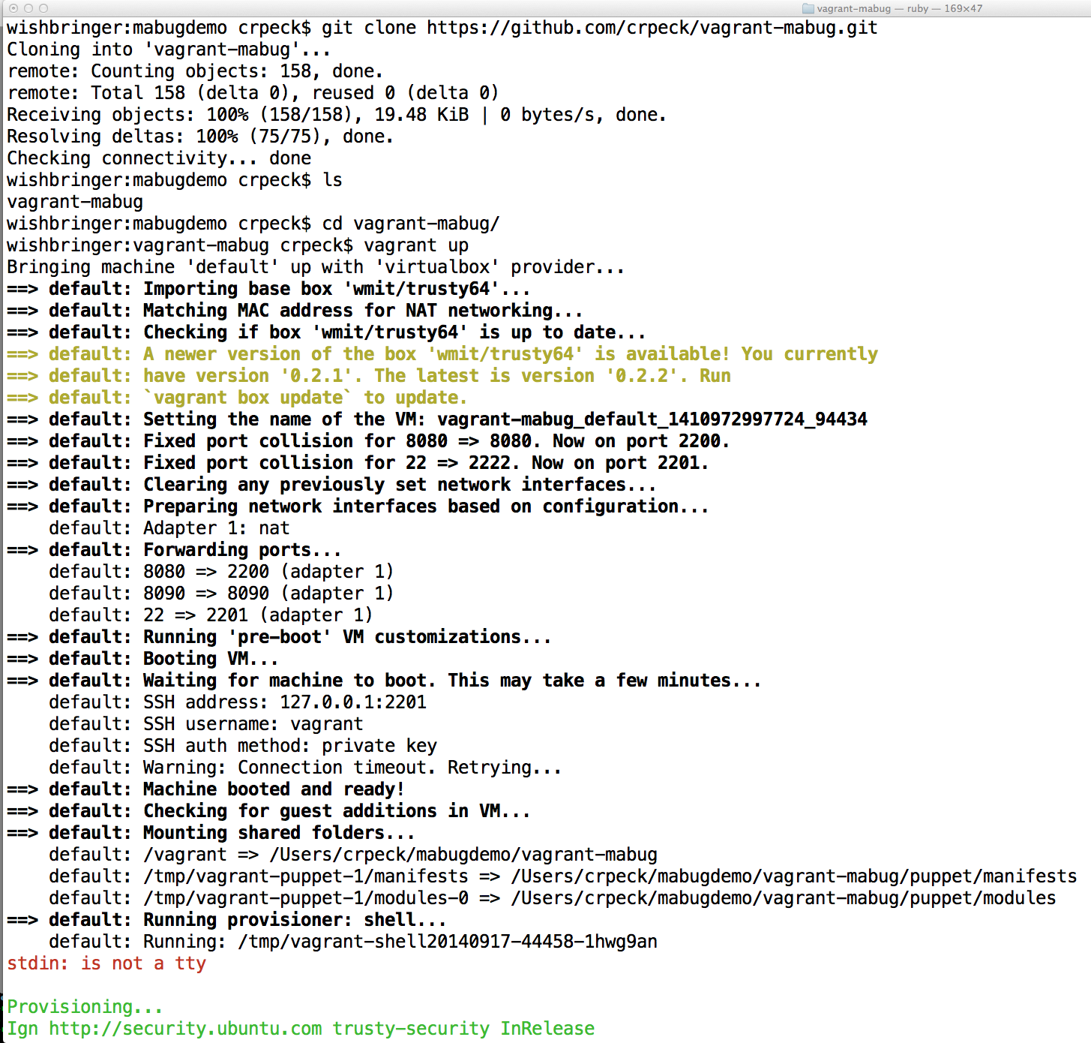

Slide 19
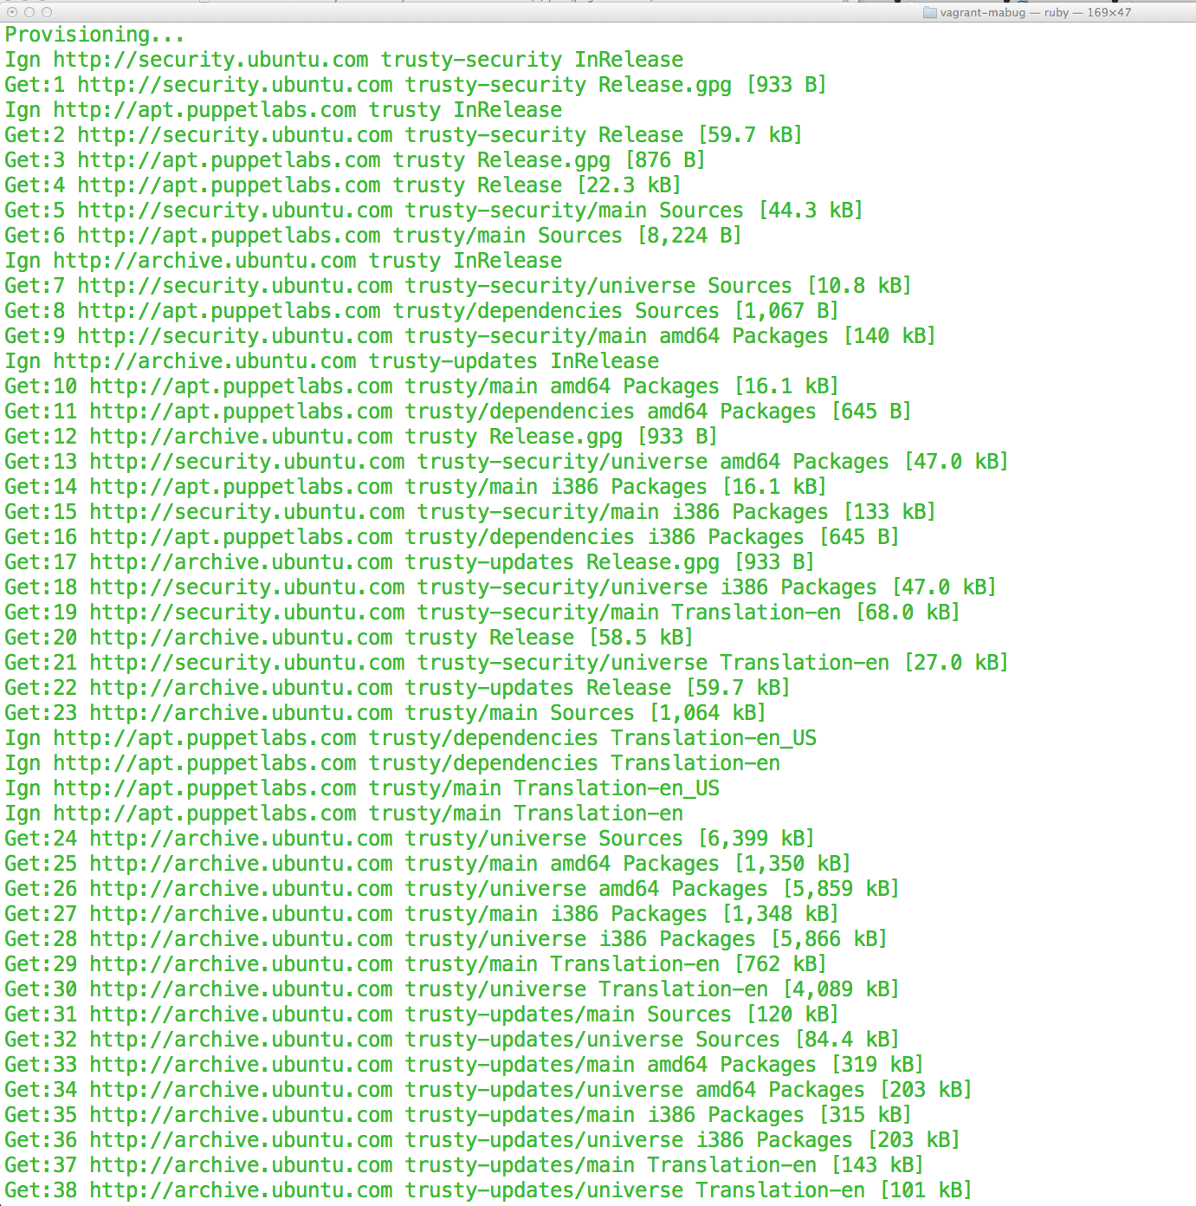

Slide 20
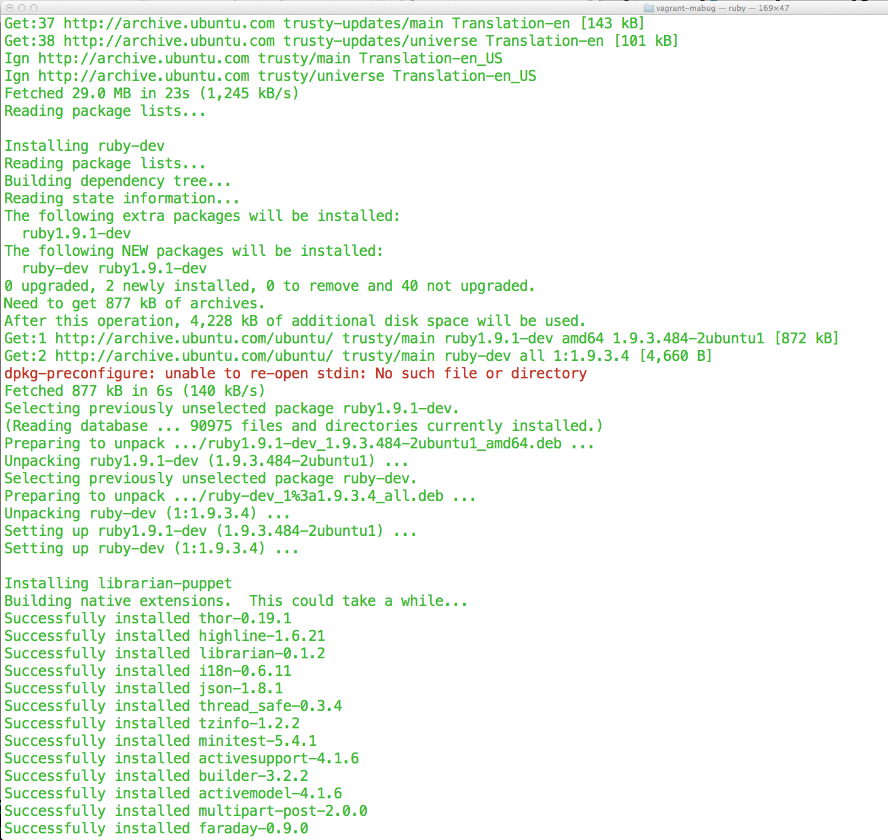

Slide 21
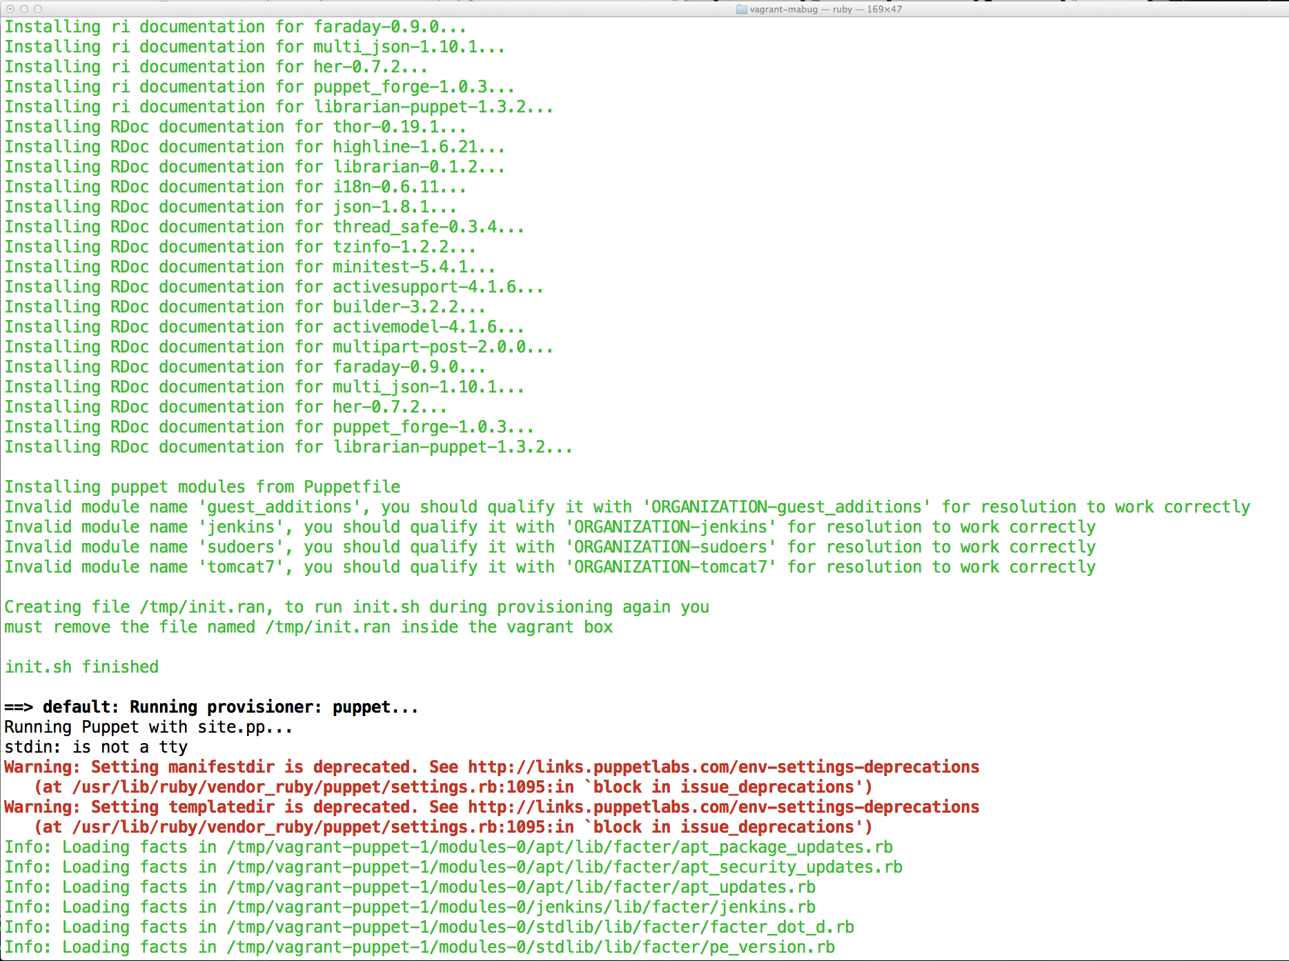

Slide 22
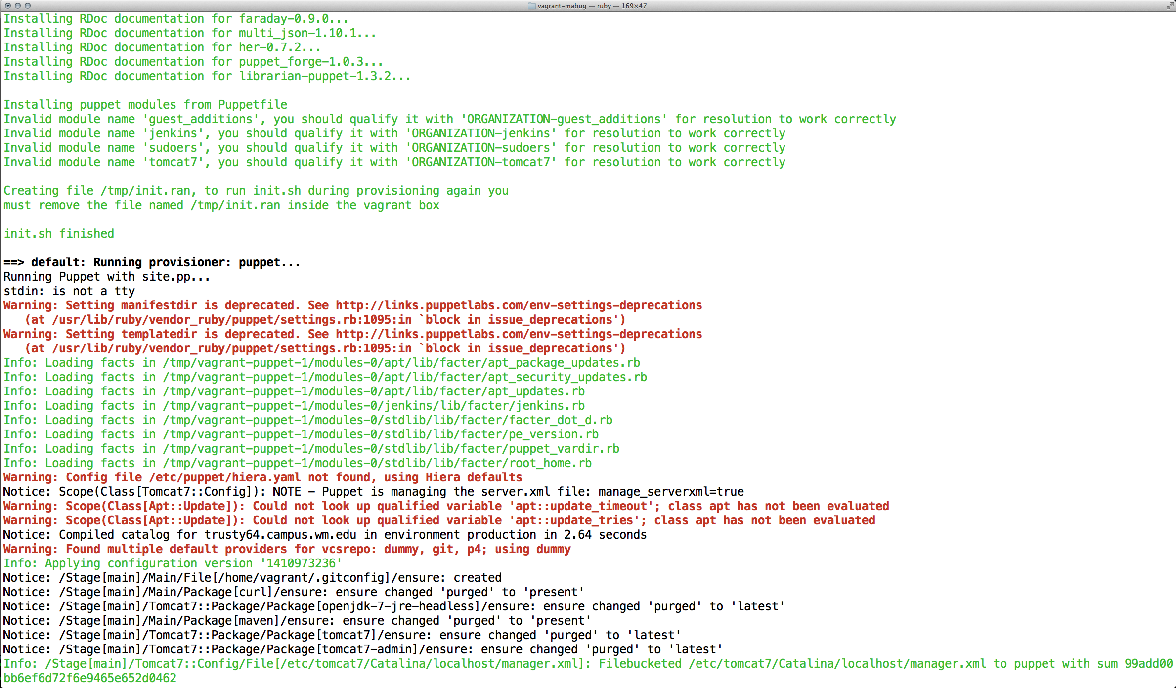

Slide 23
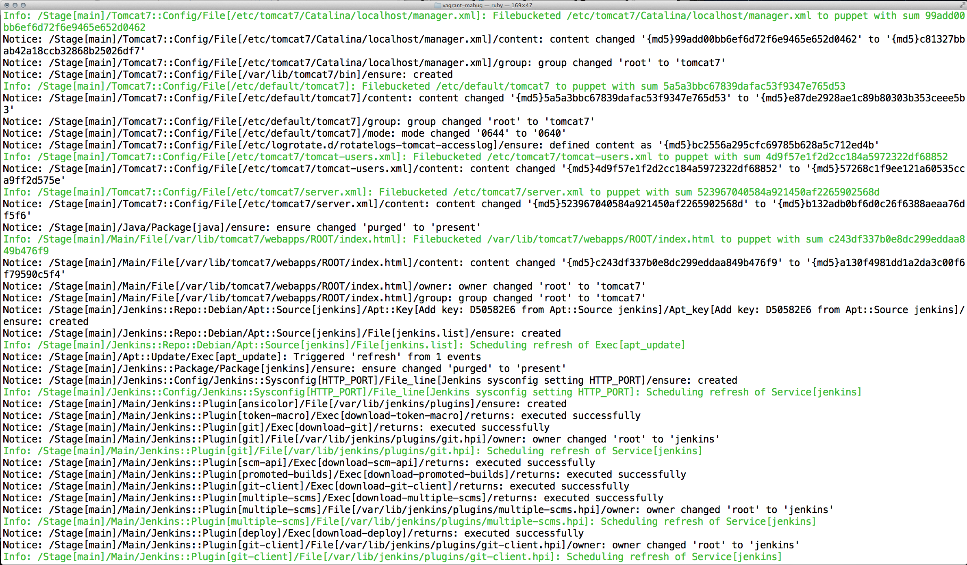

Slide 24
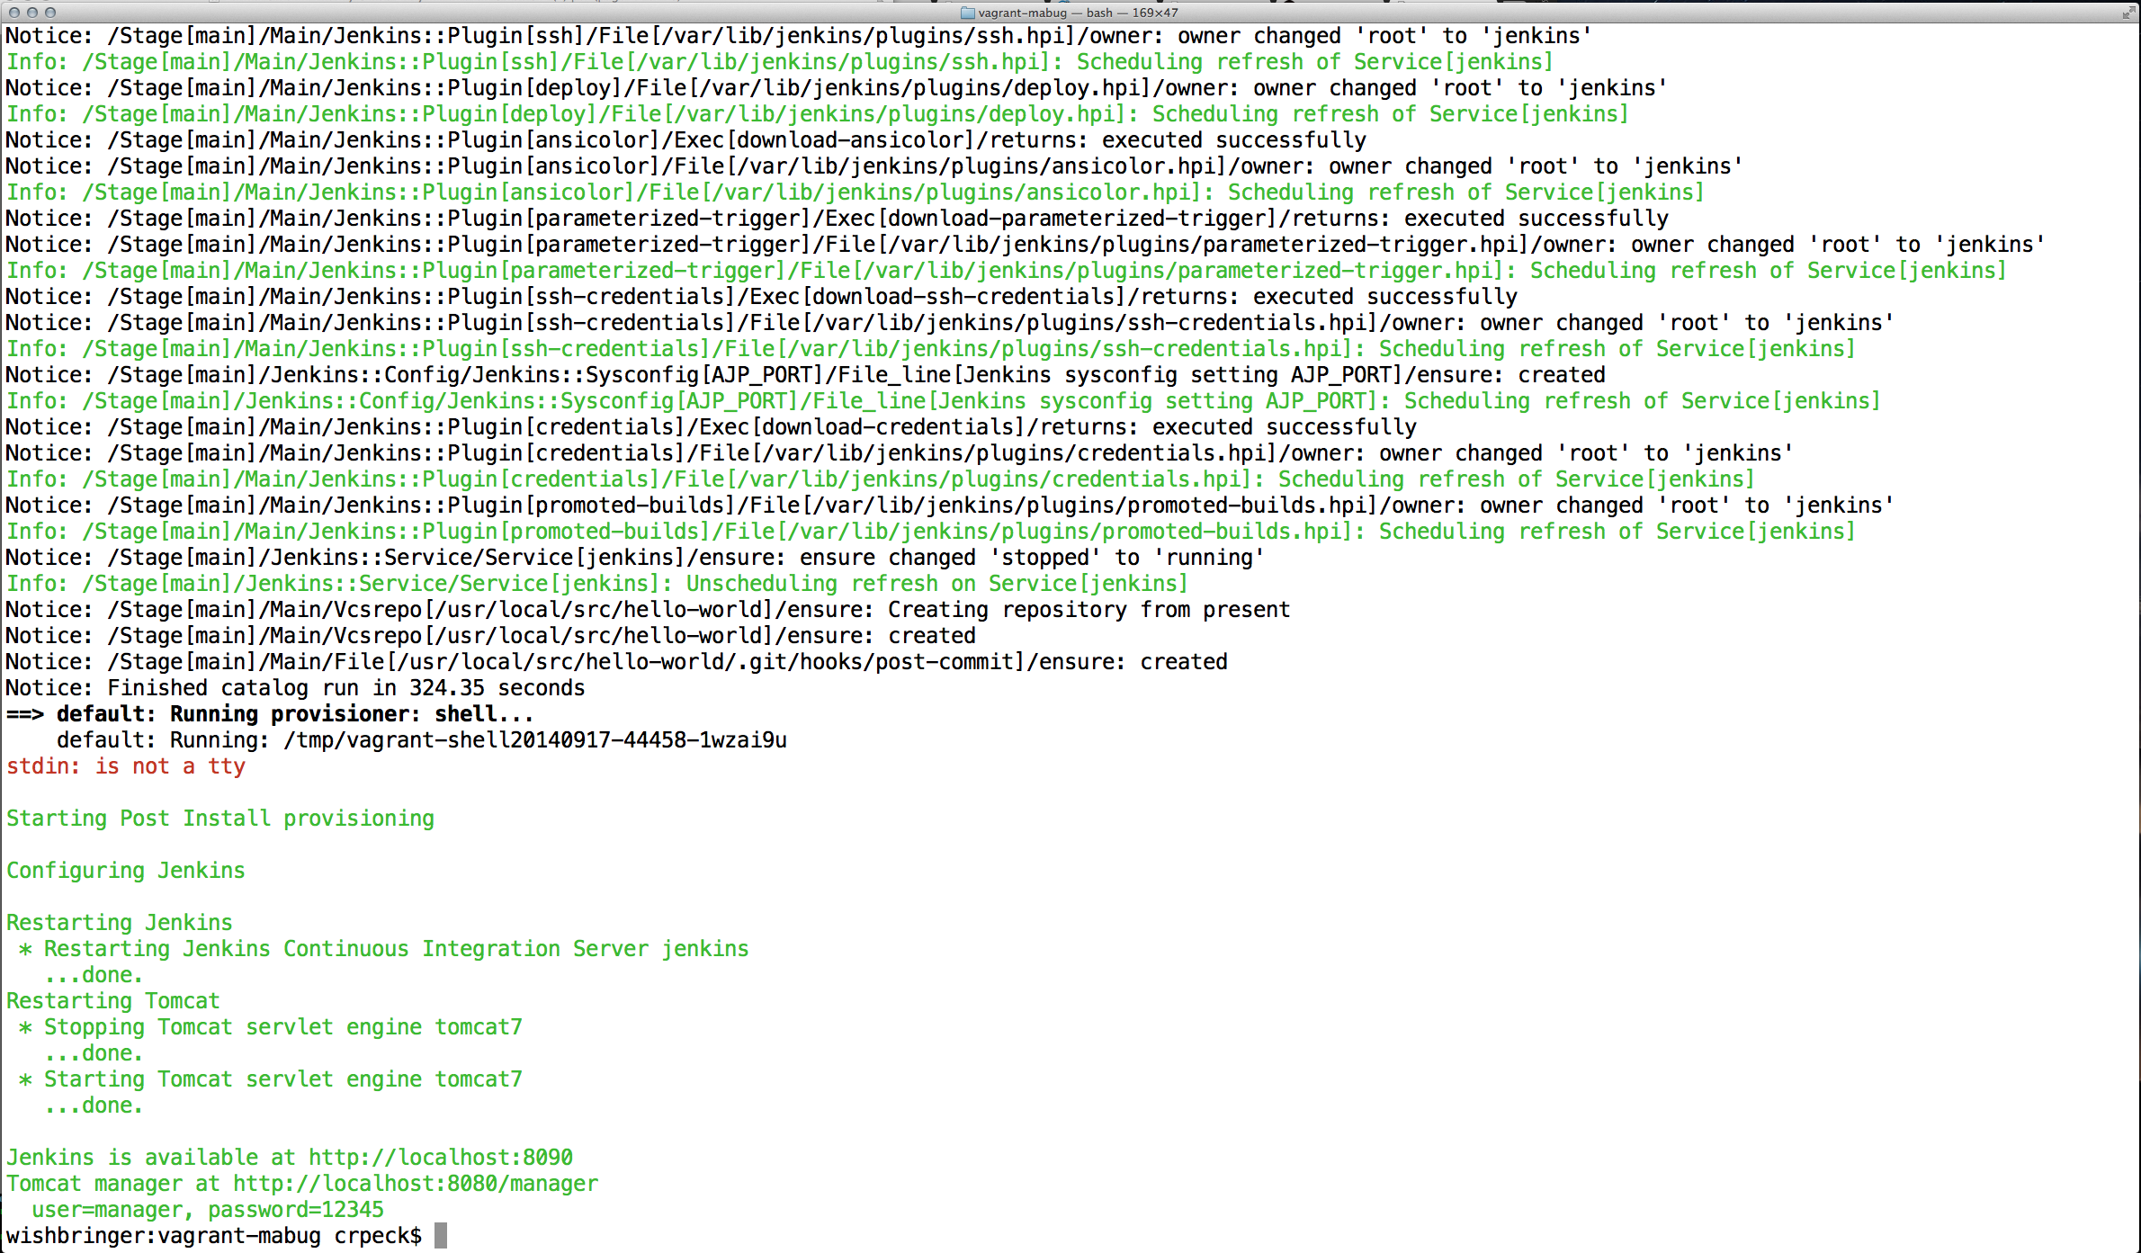

Slide 25
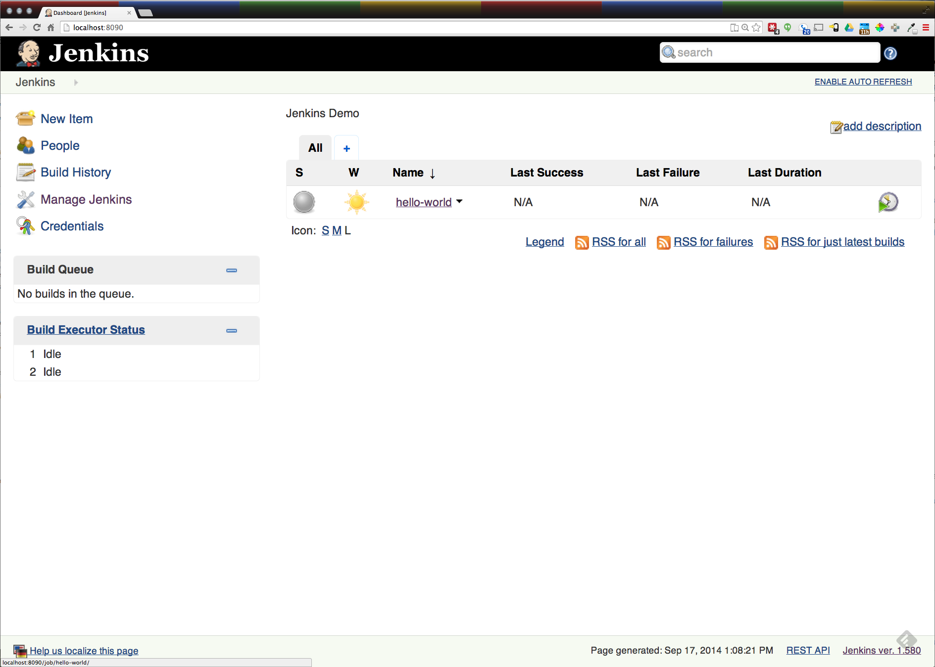

Slide 26


Building and Deploying XE warfile the Ellucian Way
Download the Software – this is for the Student Faculty Grade Entry:
Go to Website, login
Click on Download Center
Click on Banner Student, List versions
Find the “Patches and Releases” you need
Click the checkbox next to the “Patch” you need
Check the “I wish to FTP” box
Click on “ZIP Selected Files”
Click on “Move Your Zip File to Our FTP Server”
Click on the Red “New! Now you can use this link to download your ZIP file”
Or wait for email from howard.frysinger@ellucian.com? →
Extract the file you need to start with
Unzip the file you just downloaded (it contains 2 files, a readme and a tarfile)
Untar the tarfile you just unzipped
Find the zipfile you just pulled from the tarfile, you’ll be unzipping it in a second, it’s most likely in java/release-StudentFacultyGradeEntry-9.2.0.1.zip
Now you’re ready to start the process, First - have a drink, you’ll thank me later
Notes:
Howard Frysinger is on Facebook, I googled him

Slide 27
Create a temporary directory to work from
mkdir $HOME/ban9temp
cd $HOME/ban9temp
unzip where-ever/release-StudentFacultyGradeEntry-9.2.0.1.zip
cd installer
chmod +x ant
./ant
bin/install home
Prompted for full path of module home & shared configuration directory, we’ll use /home/xeuser/banner_test_homes
Go and make all your local modifications

Slide 28
Regenerate the WAR file
cd /home/xeuser/banner_test_homes/current/installer
./ant
bin/systool war
Warfile is in /home/xeuser/banner_test_homes/current/dist
Deploy it

Slide 29
References
https://github.com/crpeck/mabug-2014
https://github.com/crpeck/vagrant-mabug
https://jenkins-ci.org
http://git-scm.com
https://www.vagrantup.com
https://www.virtualbox.org
http://puppetlabs.com

Slide 30
Questions & Answers

Slide 31
Thank You for Attending!
Chris Peck
crpeck@wm.edu
@crpeck
Stick around for DevOps in a Banner World!
Please complete the session evaluation for
Automated Build and Deployment of Tomcat Apps
Session ID#: 8743

